Slide 1
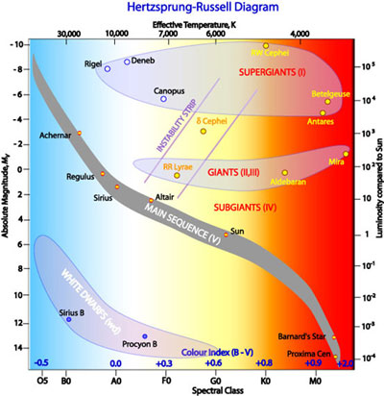
effective temperature [K]
30000
10000
7000
6000
4000
10
-8
-6
-4
-2
0
2
absolute magnitude
4
6
8
10
12
14

Slide 2
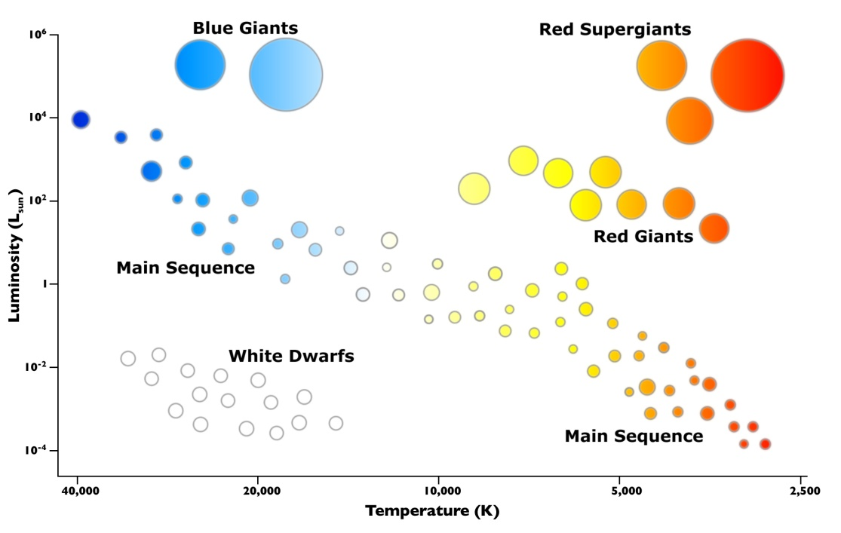
luminosity (L_{Sun})
absolute magnitude
blue giants
red supergiants
10⁶
-10
-8
10⁴
-6
main sequence
-4
-2
10²
0
red giants
2
1
4
Sun
6
white dwarfs
8
10⁻²
10
12
10⁻⁴
main sequence
14
40000
20000
10000
5000
2500
effective temperature [K]
O
B
A
F
G
K
M
spectral class
-0.5
0
+0.3
+0.6
+0.8
+0.9
colour index (B-V)

Slide 3
luminosity (L_{Sun})
absolute magnitude
blue giants
red supergiants
10⁶
-10
-8
10⁴
-6
main sequence
-4
-2
10²
0
2
1
red giants
4
Sun
6
white dwarfs
8
10⁻²
10
12
10⁻⁴
main sequence
14
40000
20000
10000
5000
2500
effective temperature [K]
O
B
A
F
G
K
M
spectral class

Slide 4
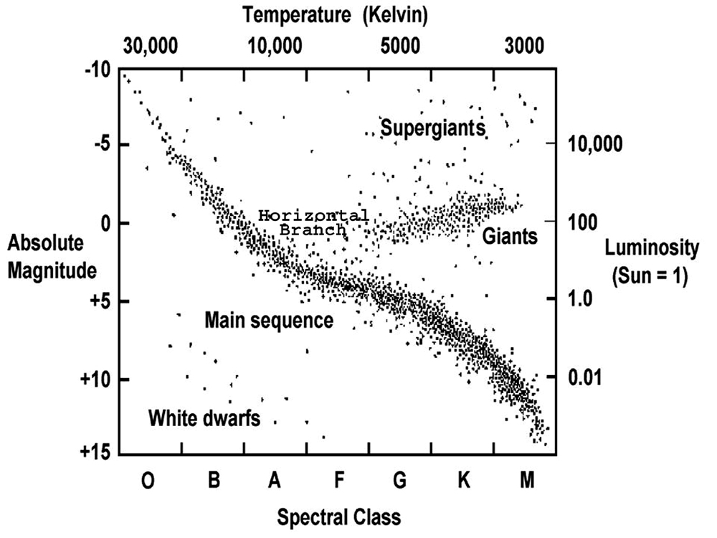

Slide 5
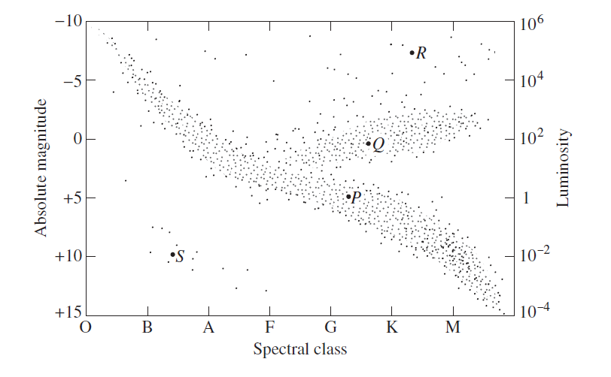
luminosity
absolute magnitude
spectral class

Slide 6
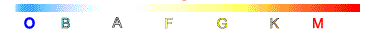

Slide 7
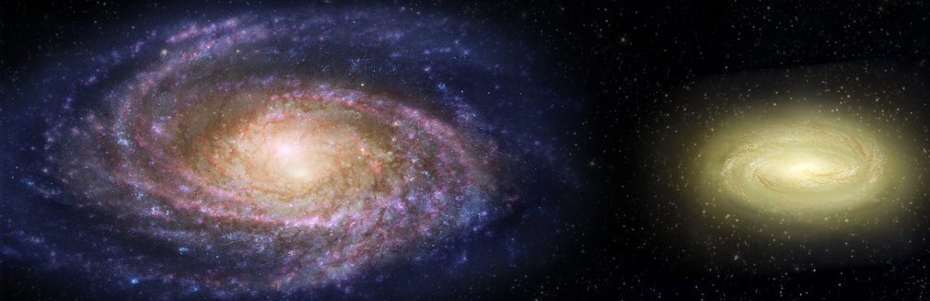
separation velocity v

Slide 8
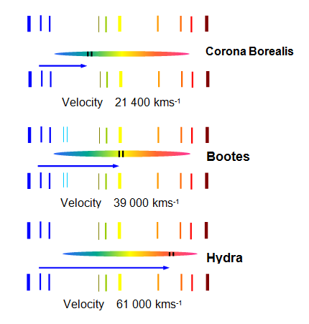
v = 21.4x10⁶ m.s⁻¹
v = 39x10⁶ m.s⁻¹
v = 61x10⁶ m.s⁻¹

Slide 9
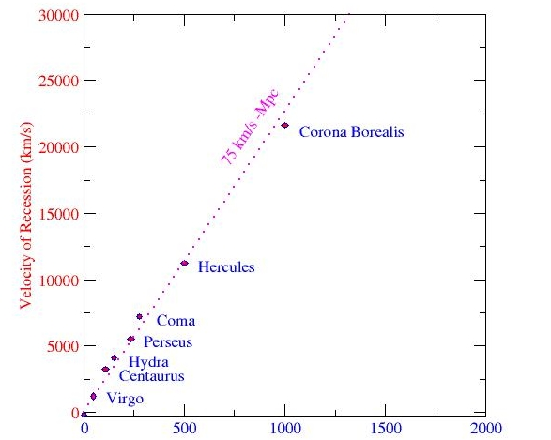
recession velocity [km.s⁻¹]
distance [x10⁶ light years]

Slide 10
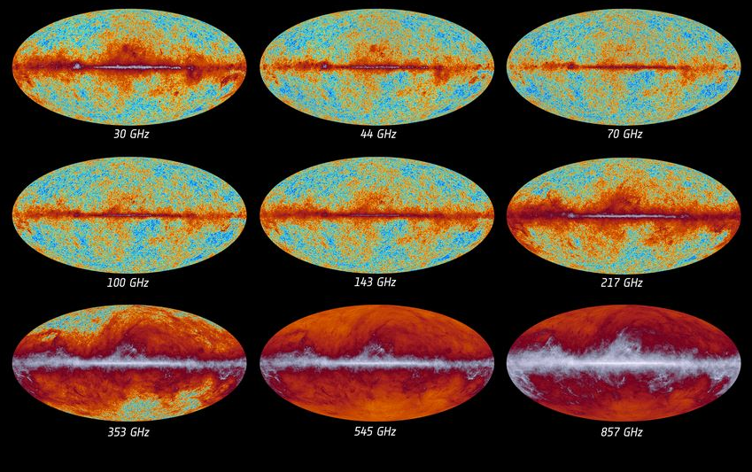
30 GHz
44 GHz
70 GHz
100 GHz
143 Hz
217 Hz
353 GHz
545 GHz
852 GHz

Slide 11
10⁻²
Stars & Galaxies
neutral atoms
10²
formation of nuclei
10⁶
electromagnetic and weak interactions separate
10¹⁰
Universe becomes transparent to radiation
10¹⁴
Strong force separates
T [K]
10¹⁸
Quarks combine to form neutrons and protons
Gravity
separates
Hot
electron-quark soup
10²²
10²⁶
GUT theories apply
10³⁰
Theory of everything
10⁻⁴³
10⁻³³
10⁻²³
10⁻¹³
10⁻³
10⁷
10¹⁷
t [s]
1 year
today

Slide 12
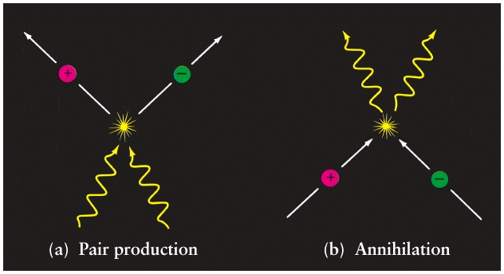

Slide 13
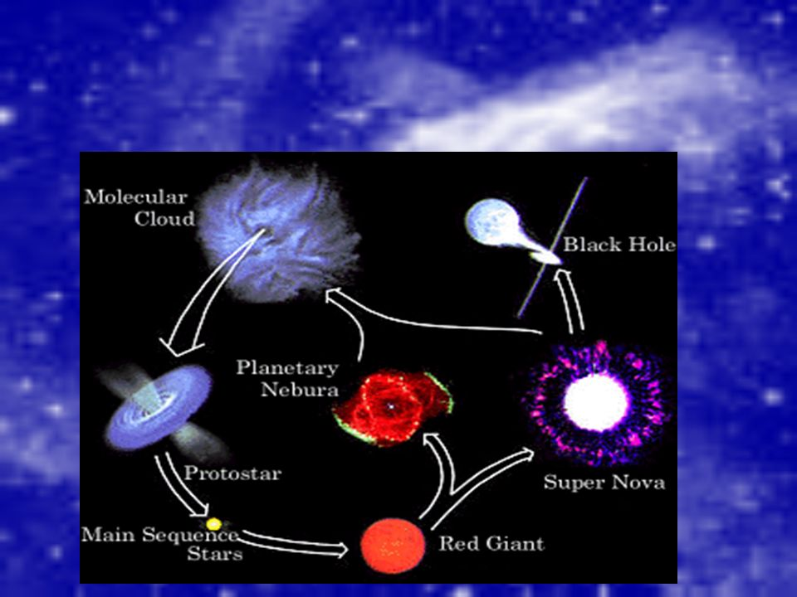
molecular
cloud
neutron
star
black
hole
planetary nebula
protostar
super
nova
main sequence star
red giant

Slide 14
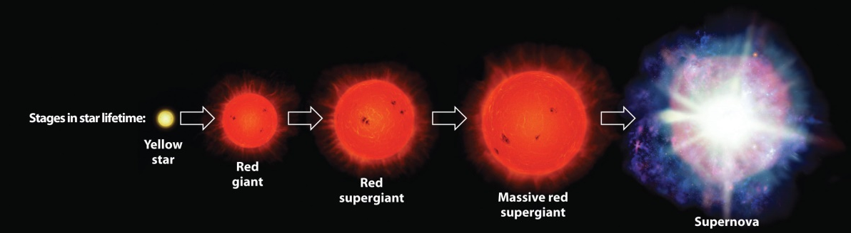
yellow
star
red
giant
red
supergiant
massive red
supergiant
supernova
T [K]
1.5x10⁷
2x10⁸
7x10⁸
3x10⁹
1x10¹¹
reactions
¹H
fusion
⁴He
fusion
⁴He + ¹²C
¹²C+¹²C
¹²C+¹⁶O
proton-neutron
exchange reactions
multiple neutron captures
elements formed
He
C O Ne
Mg
Na Si S
Ar Ca
Fe Ni
elements
Z > 28

Slide 15
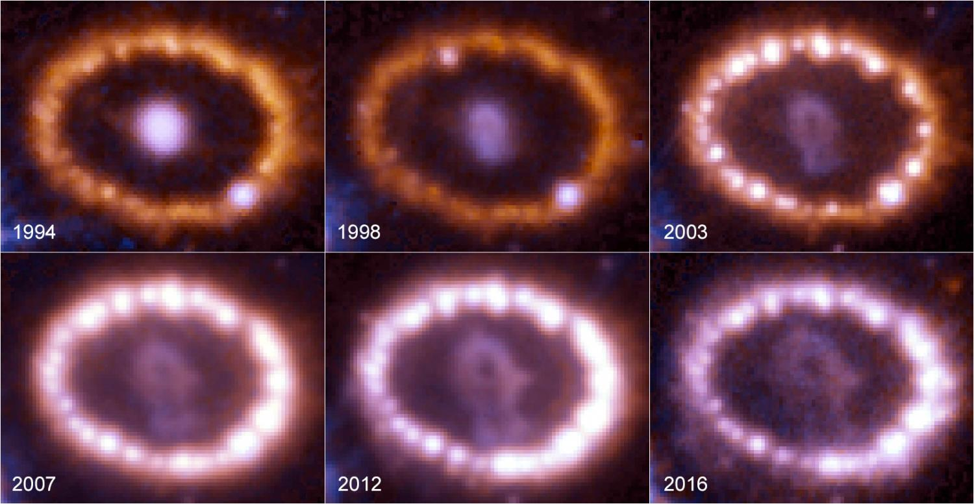

Slide 16
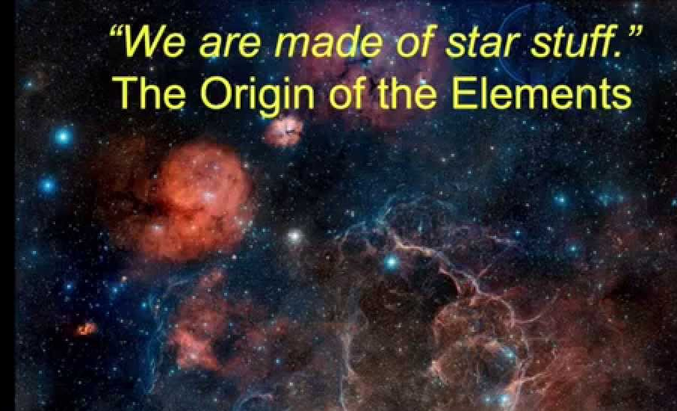

Slide 17
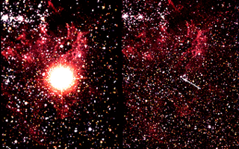
original star

Slide 18
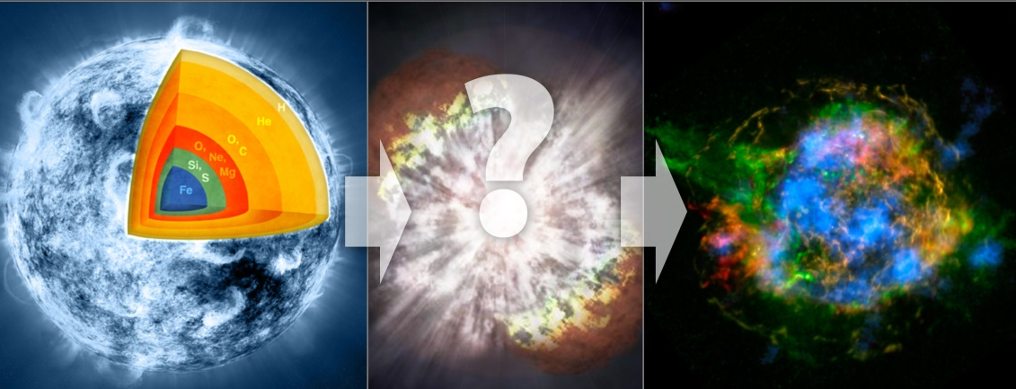

Slide 19


Slide 20
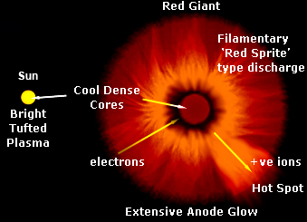

Slide 21


Z → 94
H
supernova remnants
O
C
He
Ne
Si
O
S
Fe
Mg
neutron star
or black hole
Fe → U Np Pu
we are exploding star stuff

Slide 22
x x x x x x x x x x
x x x x x x x x x x
x x x x x x x x x x
x x x x x x x x x x
x x x x x x x x x x
x x x x x x x x x x
x x x x x x x x x x
x x x x x x x x x x
x x x x x x x x x x
+
8.0 mm
120 V
electron
beam
_
I ← B x F_{B} ↓

Slide 23
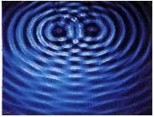
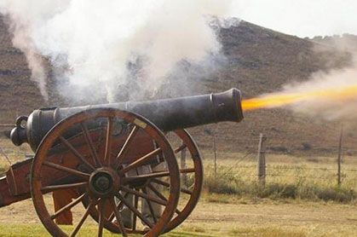

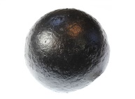
What is a wave and its characteristics?
What is a particle its characteristics?

Slide 24
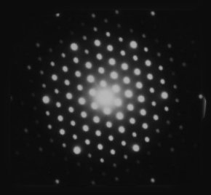
An interference pattern produced by electrons passing through a crystal. The electron beam shows wave properties because of the interference pattern but an electron behaves like a particle on hitting the screen behind the crystal.

Slide 25
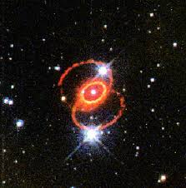
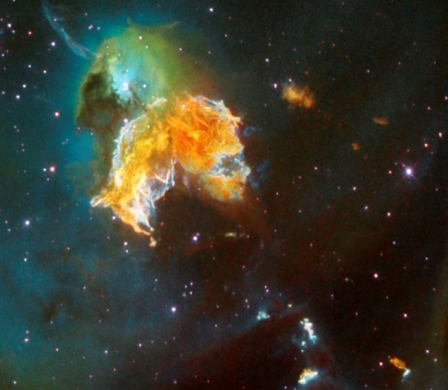
1987a
Menagerie

Slide 26
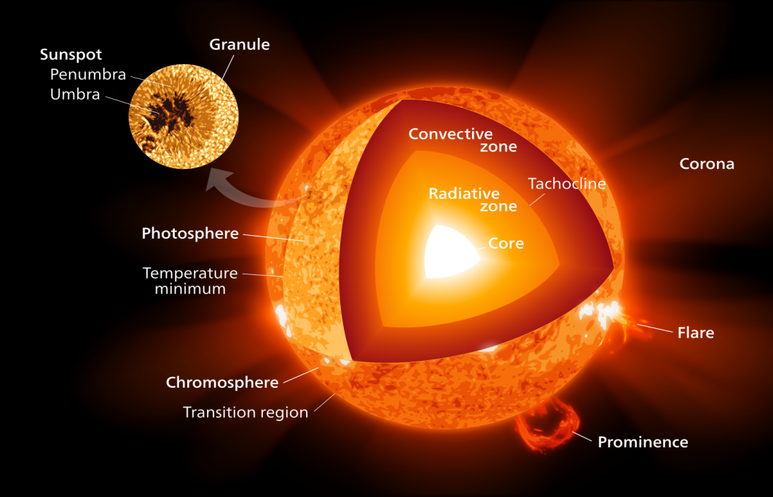
By Kelvinsong - Own work, CC BY-SA 3.0, https://commons.wikimedia.org/w/index.php?curid=23371669

Slide 27
